Slide 1
Al-Farabi Kazakh National University
Higher School of Medicine
The human genome. Part II
Lecturer: PhD Pinsky Ilya Vladimirovich

Slide 2
LEARNING OUTCOMES
As a result of the lesson you will be able to:
1. Give the definitions of genomics, proteomics and bioinformatics, describe their research methods.
2. Explain the Sanger, Maxam-Gilbert, NGS (New Generation Sequencing) and other methods of genome sequencing.
3. Characterize and analyze the main methods of protein research: two-dimensional gel electrophoresis, mass spectrometry, chromatography, X-ray structural analysis, nuclear magnetic resonance.
4. Describe EMBL-EBI, DDJB, NCBI, PIR, MIPS, NBRF, SwissProt, UniProt and other bioinformatical databases.
5. Give the definition of molecular diagnostics and describe its various methods.
6. Explain the reasons for choosing different methods of molecular diagnostics to detect different types of hereditary diseases (gene, chromosomal and genomic), infectious diseases and metabolic diseases, give specific examples.
7. Discuss the ethics of conducting genetic and molecular biological experiments on humans.

Slide 3
Literature:
1. Brown TA (2002). The Human Genome (2nd ed.). Oxford: Wiley-Liss.
2. Francis S. Collins. Medical and Societal Consequences of the Human Genome Project // N Engl J Med 1999; 341:28-37. DOI: 10.1056/NEJM199907013410106
3. Alberts et al., pp. 287-292.

Slide 4
https://www.google.com/url?sa=i&url=https%3A%2F%2Fwww.genomicseducation.hee.nhs.uk%2Feducation%2Fcore-concepts%2Fwhat-is-genomics%2F&psig=AOvVaw1bNaC7FznP7KiWhXZuRAn1&ust=1639319949979000&source=images&cd=vfe&ved=0CAwQjhxqFwoTCLjV2vX82_QCFQAAAAAdAAAAABAT

Slide 5
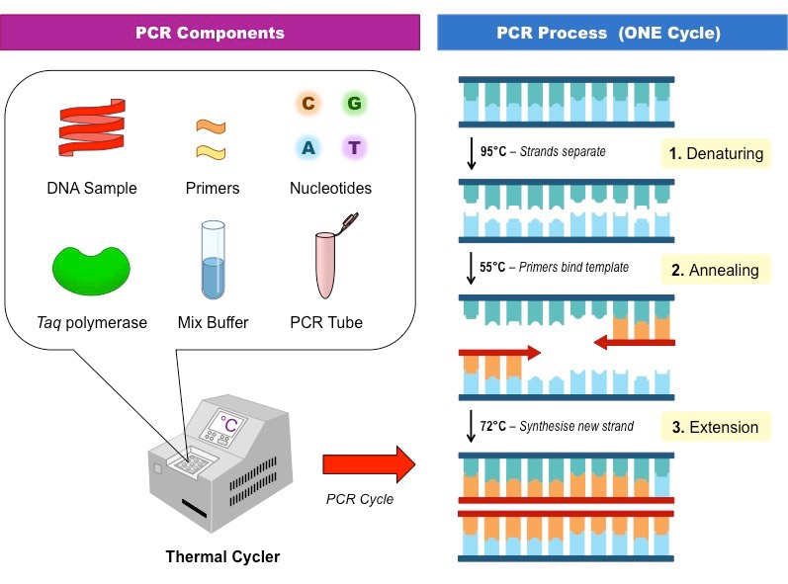
https://www.google.com/url?sa=i&url=http%3A%2F%2Fib.bioninja.com.au%2Fstandard-level%2Ftopic-3-genetics%2F35-genetic-modification-and%2Fpcr.html&psig=AOvVaw3Oko8739rF6IZzNvqKXz_K&ust=1639316633588000&source=images&cd=vfe&ved=0CAwQjhxqFwoTCOi578Dw2_QCFQAAAAAdAAAAABAU

Slide 6
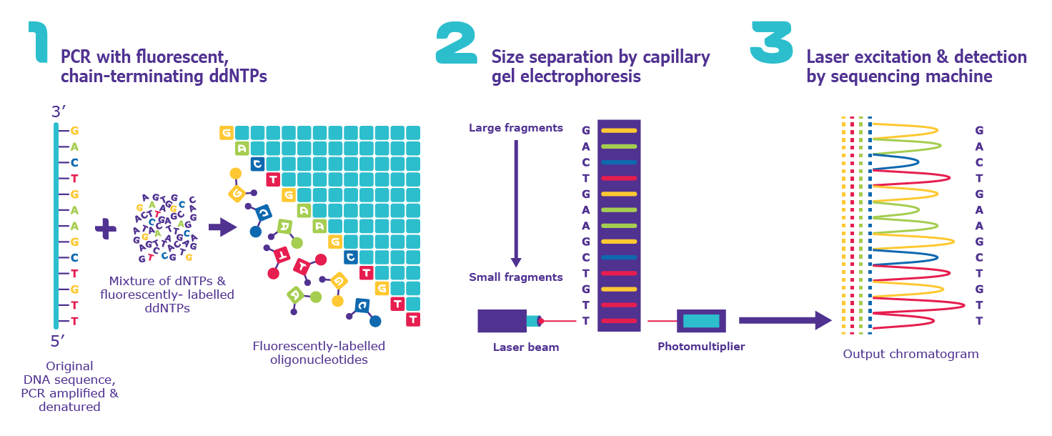
Sanger sequencing
https://www.google.com/url?sa=i&url=https%3A%2F%2Fwww.sigmaaldrich.com%2FUS%2Fen%2Ftechnical-documents%2Fprotocol%2Fgenomics%2Fsequencing%2Fsanger-sequencing&psig=AOvVaw2rdu4oNXfjNravAjMwYuY1&ust=1639316174409000&source=images&cd=vfe&ved=0CAwQjhxqFwoTCNC51uvu2_QCFQAAAAAdAAAAABAD

Slide 7
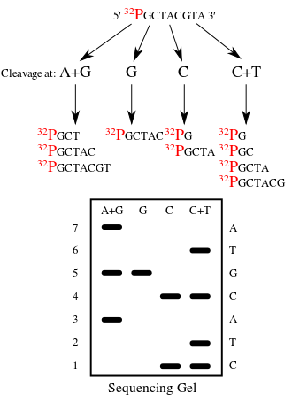
Maxam-Gilbert DNA sequencing
https://www.google.com/url?sa=i&url=https%3A%2F%2Fen.wikipedia.org%2Fwiki%2FMaxam%25E2%2580%2593Gilbert_sequencing&psig=AOvVaw3RVKWZLaWNIi7yFT33MGtI&ust=1639316425287000&source=images&cd=vfe&ved=0CAwQjhxqFwoTCOCK8d_v2_QCFQAAAAAdAAAAABAT

Slide 8
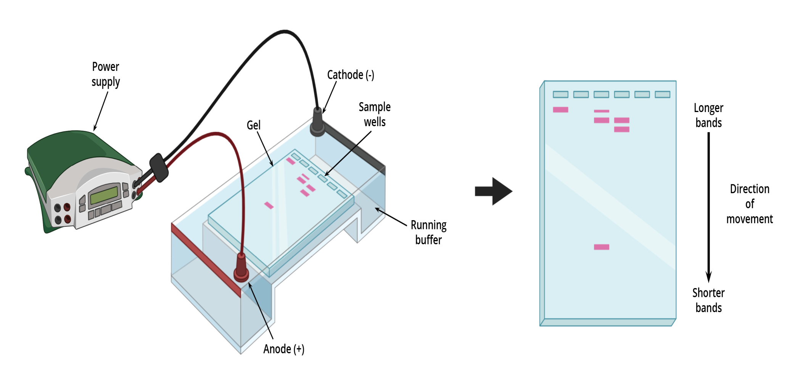
Gel electrophoresis
https://www.google.com/url?sa=i&url=https%3A%2F%2Fwww.aatbio.com%2Fcatalog%2Fgel-electrophoresis&psig=AOvVaw2_CVxObvGa-xo9iLZPuO-D&ust=1639317093785000&source=images&cd=vfe&ved=0CAwQjhxqFwoTCJCp6Zzy2_QCFQAAAAAdAAAAABAd

Slide 9
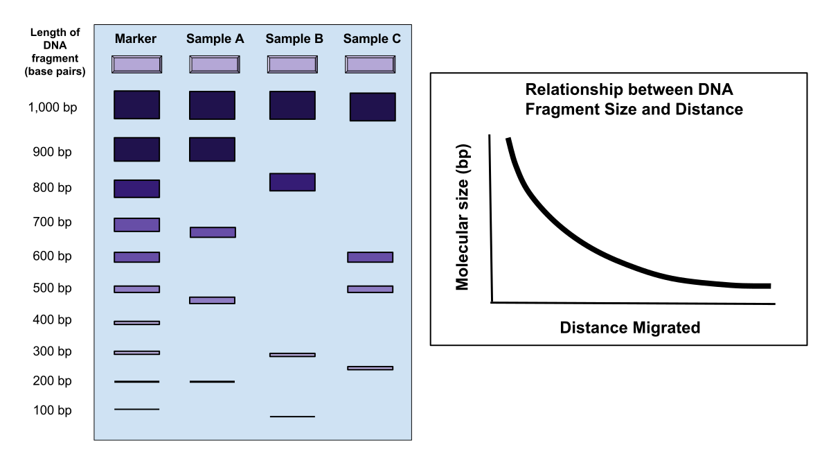
https://www.google.com/url?sa=i&url=https%3A%2F%2Fcommons.wikimedia.org%2Fwiki%2FFile%3AGel_Electrophoresis.svg&psig=AOvVaw2_CVxObvGa-xo9iLZPuO-D&ust=1639317093785000&source=images&cd=vfe&ved=0CAwQjhxqFwoTCJCp6Zzy2_QCFQAAAAAdAAAAABAY

Slide 10
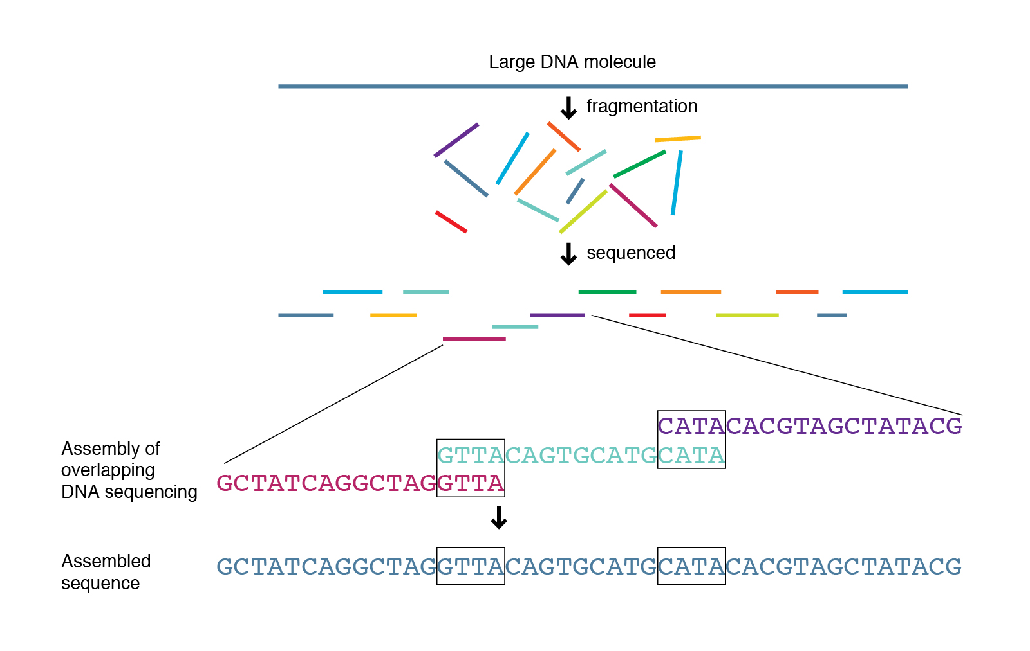
Shortgun sequencing
https://www.genome.gov/genetics-glossary/Shotgun-Sequencing

Slide 11
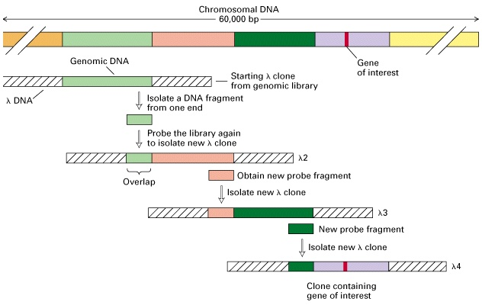
Chromosome walking
https://www.google.com/url?sa=i&url=http%3A%2F%2Fgvbioteck.blogspot.com%2F2012%2F09%2Fchromosome-walking.html&psig=AOvVaw1Efr8a66zZIvm2f80hb2UM&ust=1614627414190000&source=images&cd=vfe&ved=2ahUKEwjbkIH9qY3vAhWYuyoKHan9AbIQr4kDegUIARC2AQ

Slide 12
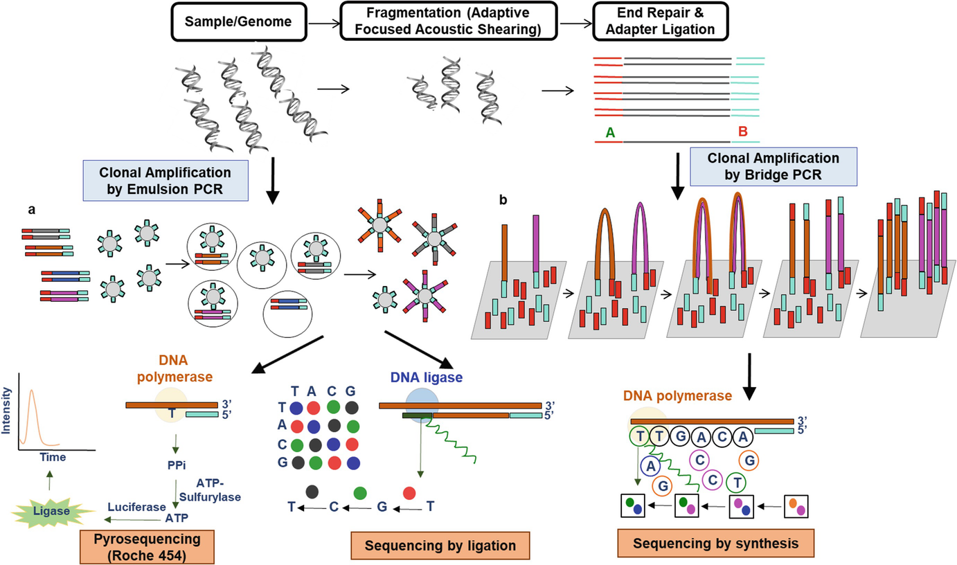
https://www.google.com/url?sa=i&url=https%3A%2F%2Flink.springer.com%2Fchapter%2F10.1007%2F978-981-13-8844-6_15&psig=AOvVaw2ptBt4IA_4iW8n0Gfutlp_&ust=1639316858064000&source=images&cd=vfe&ved=0CAwQjhxqFwoTCMD98a3x2_QCFQAAAAAdAAAAABAS

Slide 13
https://www.google.com/url?sa=i&url=https%3A%2F%2Fwww.slideshare.net%2Fappyakshay%2Fproteomics-75139676&psig=AOvVaw28cXwhBaroSF37Tv8-ZuIR&ust=1639320177493000&source=images&cd=vfe&ved=0CAwQjhxqFwoTCJDF6ef92_QCFQAAAAAdAAAAABAJ

Slide 14
https://www.google.com/url?sa=i&url=https%3A%2F%2Fwww.youtube.com%2Fwatch%3Fv%3DFHvblg338Gg&psig=AOvVaw2a-b2b32ejmdgtrGE6WNC6&ust=1639317504236000&source=images&cd=vfe&ved=0CAwQjhxqFwoTCICm-N_z2_QCFQAAAAAdAAAAABAO

Slide 15
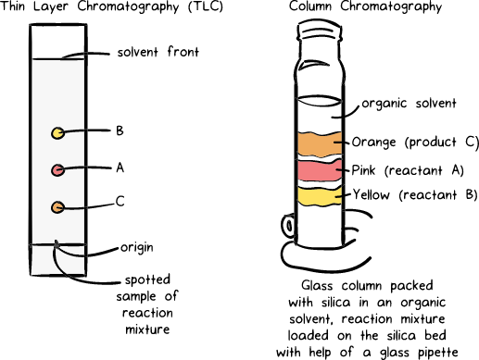
https://www.google.com/url?sa=i&url=https%3A%2F%2Fwww.khanacademy.org%2Fscience%2Fclass-11-chemistry-india%2Fxfbb6cb8fc2bd00c8%3Ain-in-organic-chemistry-some-basic-principles-and-techniques%2Fxfbb6cb8fc2bd00c8%3Ain-in-methods-of-purification-of-organic-compounds%2Fa%2Fprinciples-of-chromatography&psig=AOvVaw2dyYLSOoHpIxi4nSYuZkzR&ust=1639317967632000&source=images&cd=vfe&ved=0CAwQjhxqFwoTCNDjk7712_QCFQAAAAAdAAAAABAc

Slide 16
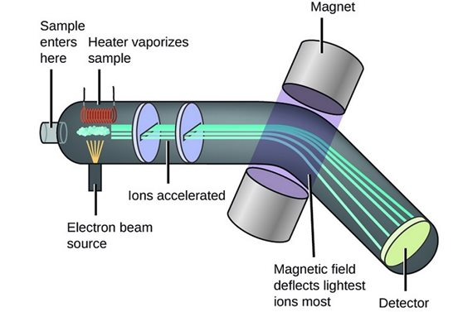
Mass-spectrometry
https://www.google.com/url?sa=i&url=https%3A%2F%2Fwww.bronkhorst.com%2Fint%2Fblog-1%2Fmass-spectrometry-and-mass-flow-control-a-closer-ion-them%2F&psig=AOvVaw1j_dPcDDEFHhQDSFqFDUee&ust=1639317740058000&source=images&cd=vfe&ved=0CAwQjhxqFwoTCKDb6NH02_QCFQAAAAAdAAAAABAR

Slide 17
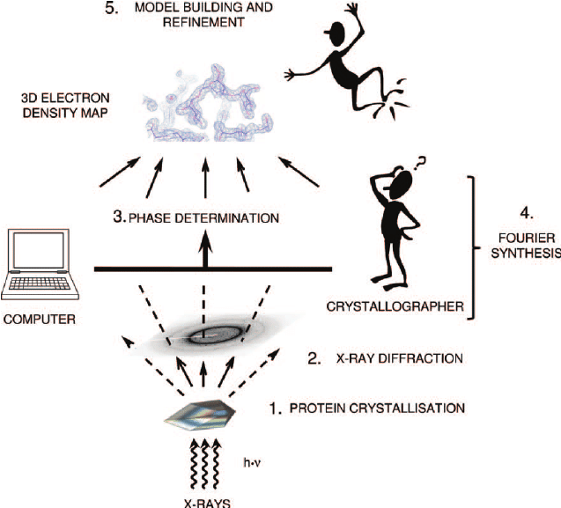
https://www.google.com/url?sa=i&url=https%3A%2F%2Fwww.researchgate.net%2Ffigure%2FOverview-of-a-protein-structure-analysis-by-X-ray-crystallography-First-the-protein_fig1_263470158&psig=AOvVaw1ptAhbp9rzobWSpedndmee&ust=1639318204925000&source=images&cd=vfe&ved=0CAwQjhxqFwoTCPiXwa722_QCFQAAAAAdAAAAABAU

Slide 18
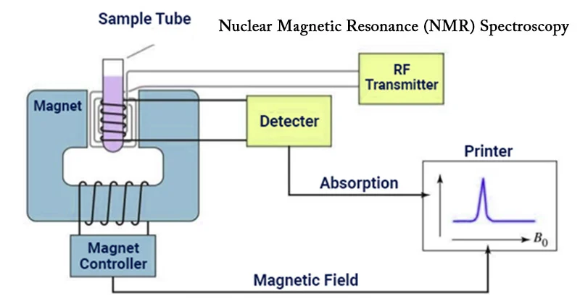
https://www.google.com/url?sa=i&url=https%3A%2F%2Fmicrobenotes.com%2Fnuclear-magnetic-resonance-nmr-spectroscopy%2F&psig=AOvVaw3wN-f2n0J9i0i29J7NJDv-&ust=1639318449004000&source=images&cd=vfe&ved=0CAwQjhxqFwoTCLDJ-qP32_QCFQAAAAAdAAAAABAs

Slide 19
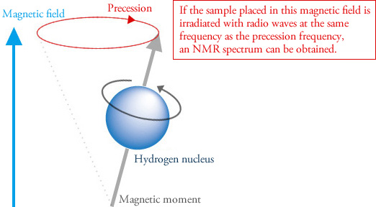
https://www.google.com/url?sa=i&url=https%3A%2F%2Fwww.jeol.co.jp%2Fen%2Fproducts%2Fnmr%2Fbasics.html&psig=AOvVaw3wN-f2n0J9i0i29J7NJDv-&ust=1639318449004000&source=images&cd=vfe&ved=0CAwQjhxqFwoTCLDJ-qP32_QCFQAAAAAdAAAAABAx

Slide 20
https://www.google.com/url?sa=i&url=https%3A%2F%2Fwww.slideshare.net%2FJTADrexel%2Fbioinformatics-2512758&psig=AOvVaw27r8THpDEy5y6IpNLMTab9&ust=1639320377690000&source=images&cd=vfe&ved=0CAwQjhxqFwoTCPix9rn-2_QCFQAAAAAdAAAAABAX

Slide 21
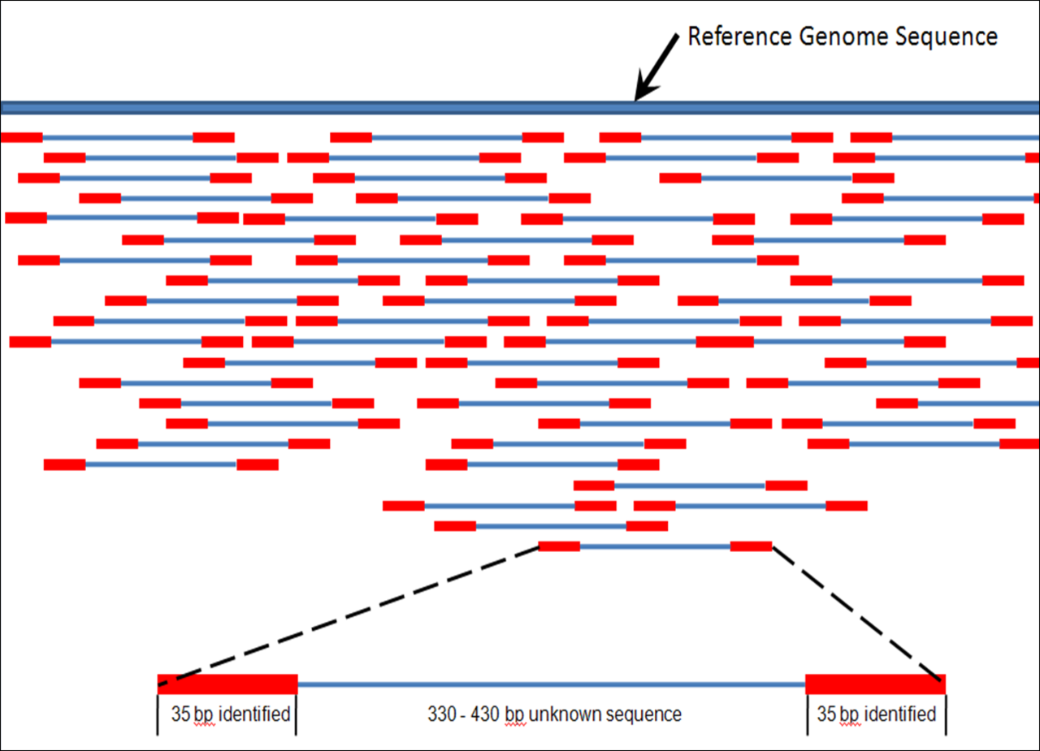
Genome assembling
https://en.wikipedia.org/wiki/Genomics#/media/File:Mapping_Reads.png

Slide 22
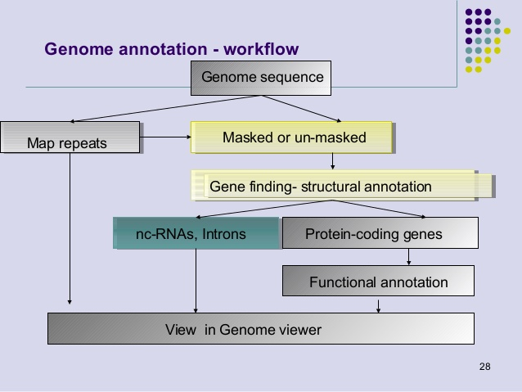
https://www.google.com/url?sa=i&url=https%3A%2F%2Fwww.slideshare.net%2Fkaranppt%2Fgenome-annotation-2013&psig=AOvVaw3W0yVtMND0yOoaRAbiACi3&ust=1614628815714000&source=images&cd=vfe&ved=2ahUKEwjtt6eZr43vAhXaBncKHVEDCNQQr4kDegUIARDIAQ

Slide 23
Types of bioinformatical databases
Archives (GeneBank & EMBL, PDB)
Curated (Swiss-Prot, KEGG, FlyBase, COG)
Derivatives (SCOP, PFAM , GO, ProDom, AsMamDB)
Integrated (NCBI Entrez, Ecocyc)

Slide 24
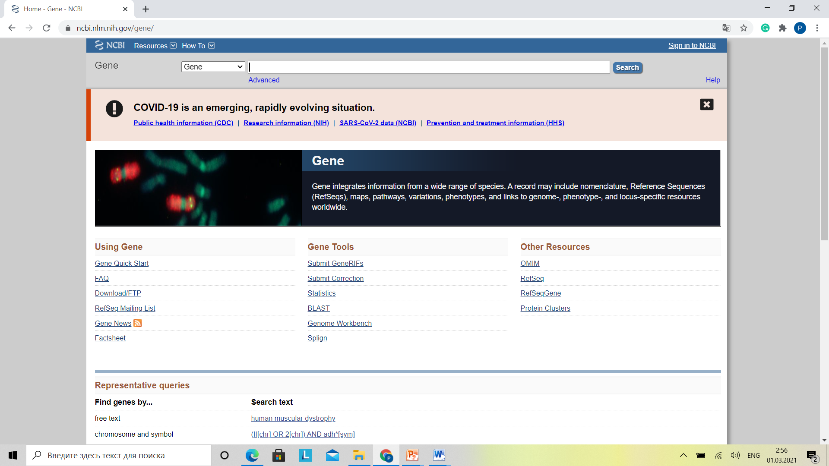

Slide 25
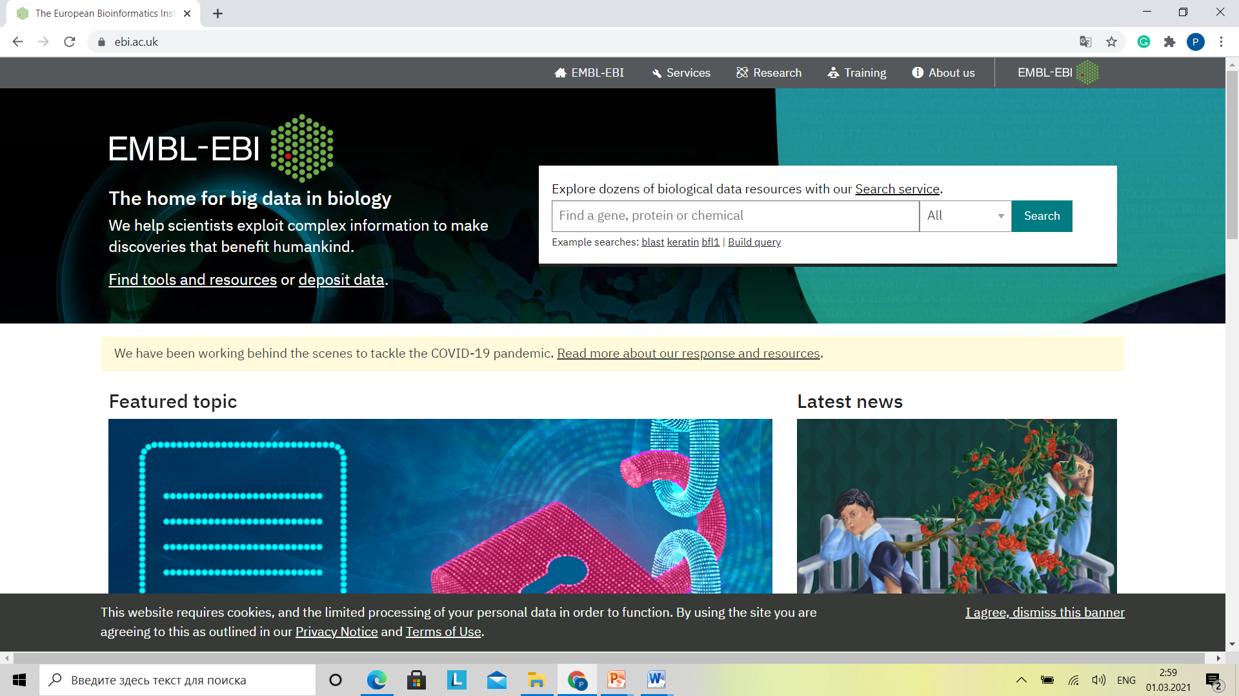

Slide 26
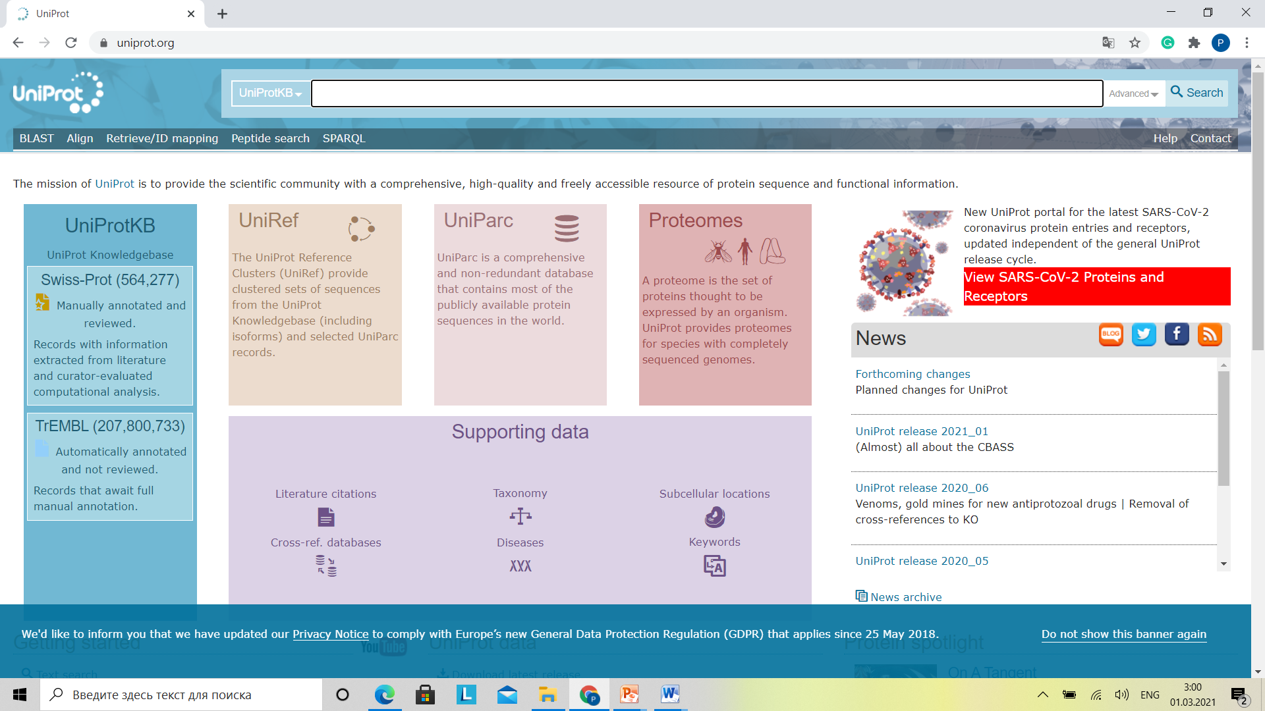

Slide 27
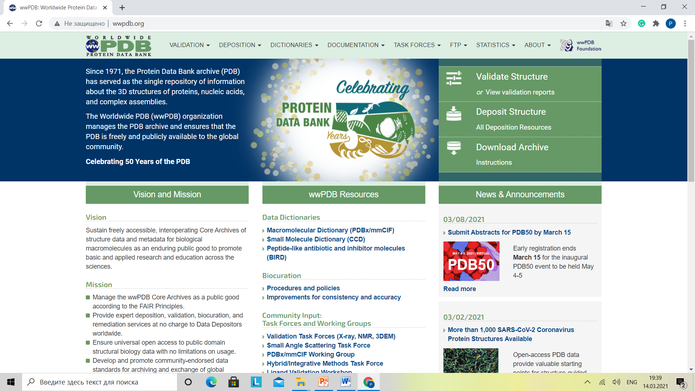

Slide 28
https://www.google.com/url?sa=i&url=https%3A%2F%2Fpt.slideshare.net%2FMeghanaMeg1%2Fmolecular-diagnostic-techniques&psig=AOvVaw1veFQnq0QOFhjFkdZh5XgY&ust=1639320677208000&source=images&cd=vfe&ved=0CAwQjhxqFwoTCMDI_sr_2_QCFQAAAAAdAAAAABAy

Slide 29
goldbio.com

Slide 30
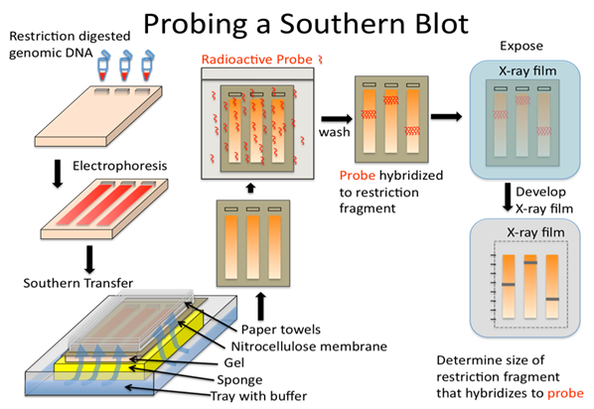
bio.libretexts.org

Slide 31
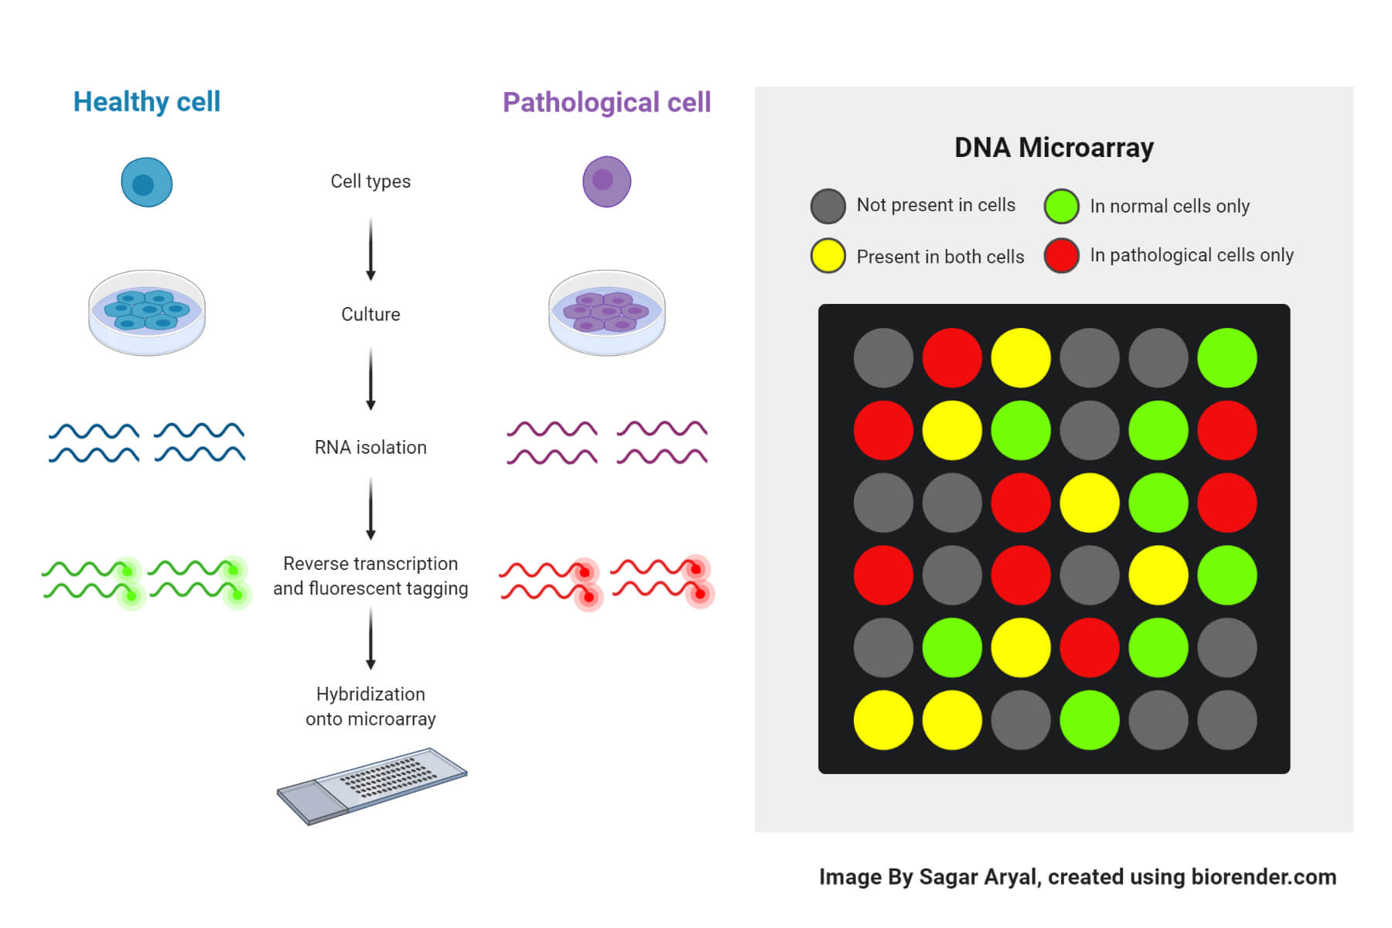
DNA microarray

Slide 32
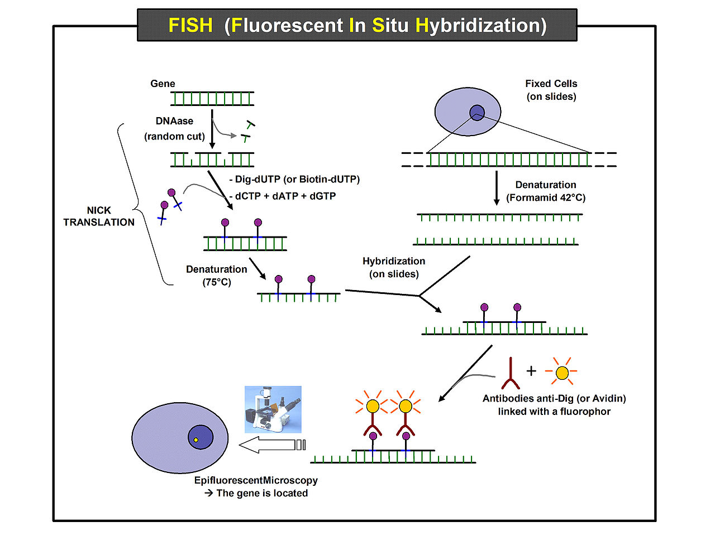
https://en.wikipedia.org/wiki/Fluorescence_in_situ_hybridization#/media/File:FISH_(Fluorescent_In_Situ_Hybridization).jpg

Slide 33
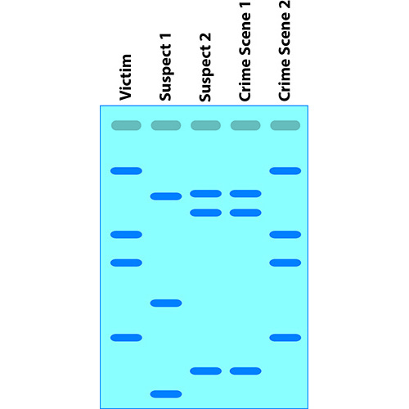
DNA fingerprinting
gbiosciences.com · In stock

Slide 34
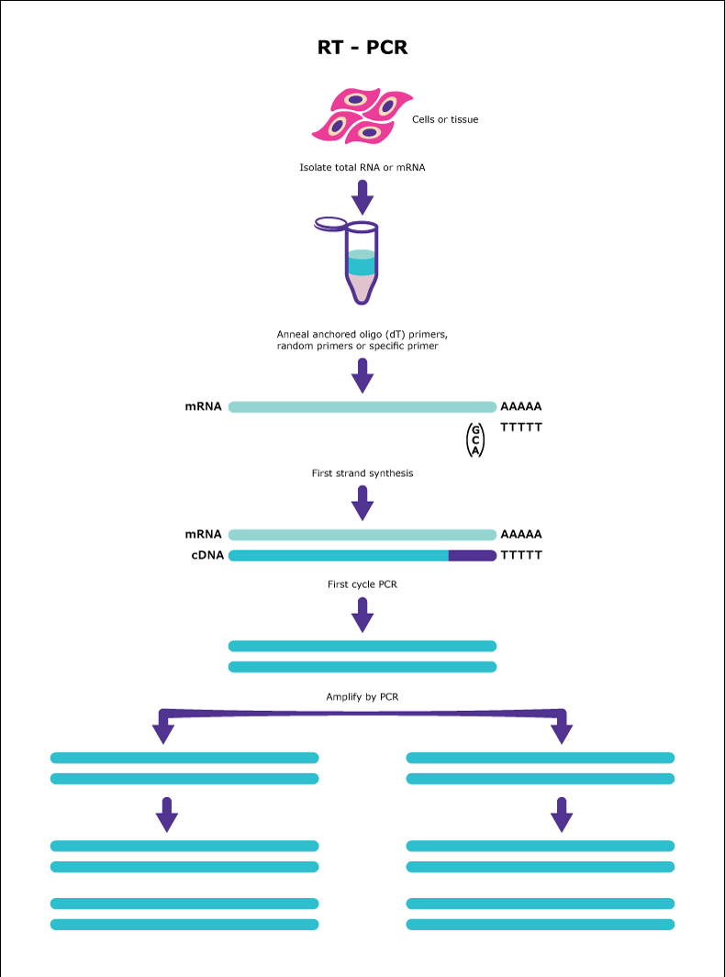
PCR diagnostics.
https://www.google.com/url?sa=i&url=https%3A%2F%2Fwww.reddit.com%2Fr%2FCOVID19%2Fcomments%2Ffb859l%2Frtpcr_diagnostics_what_are_they_and_how_do_they%2F&psig=AOvVaw2xxYqnR3Tv9-QQkfRIi37h&ust=1614630255452000&source=images&cd=vfe&ved=2ahUKEwi4g-rHtI3vAhUGwSoKHSIoDzgQr4kDegUIARC7AQ

Slide 35
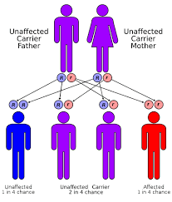
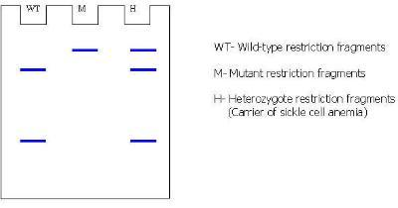
Restriction analysis (restriction fragment length polymorphism, RFLP)
Sickle Cell Anemia | Muhlenberg College
muhlenberg.edu
Sickle cell disease - Wikiwand
wikiwand.com

Slide 36
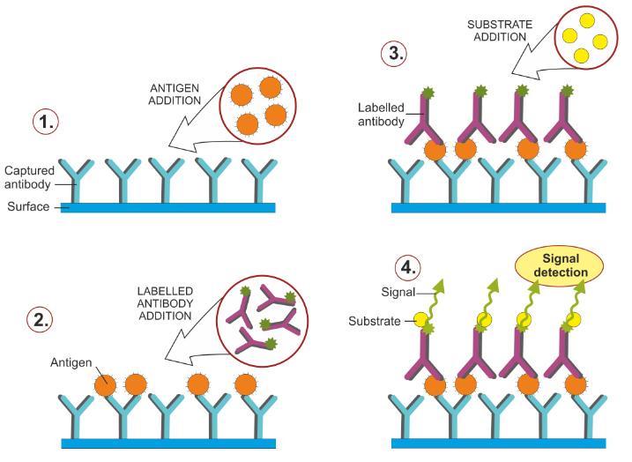
ELISA (Enzyme-linked Imunosorbent Assay)
https://www.google.com/url?sa=i&url=https%3A%2F%2Fwww.biotek.com%2Fapplications%2Felisa-and-related-immunoassays.html&psig=AOvVaw0y29nwm6zKNGseUXWXV7Gf&ust=1639338559563000&source=images&cd=vfe&ved=0CAwQjhxqFwoTCOCoyJfC3PQCFQAAAAAdAAAAABAX

